Slide 1






360° Optical Flow using Tangent Images
Mingze Yuan, Christian Richardt
University of Bath
EP/S001050/1
EP/M023281/1, EP/T022523/1

Slide 2
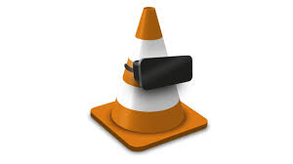
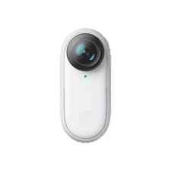
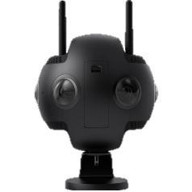
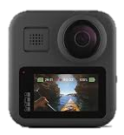
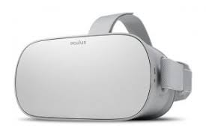
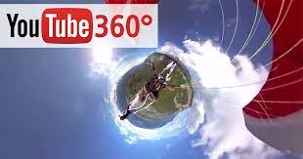
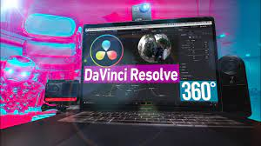
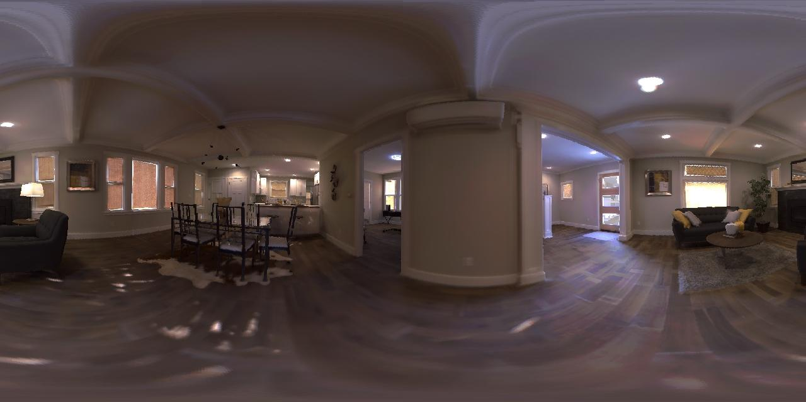
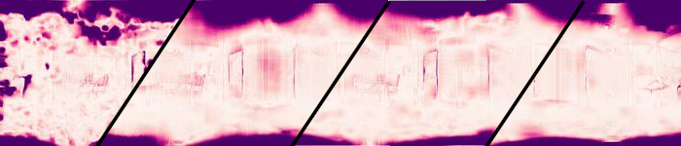

Motivation
360 Media Camera
360 Media Distribution
360 Media Display
Need Optical Flow !!
DIS
PWCNet
OmniFlow
RAFT
Optical Flow Error Heatmap (darker larger error)
360 Optical Flow using Tangent Images, MZ Yuan and C Richardt
BMVC 2021
Page 2
Notes:
360 image and video are ubiquity, including media capture, media distribution platform and media display.
And the optical flow is necessary data in 360 media processing.
The 360 image's distortion makes the perspective optical flow have more error, especially at two poles.

Slide 3
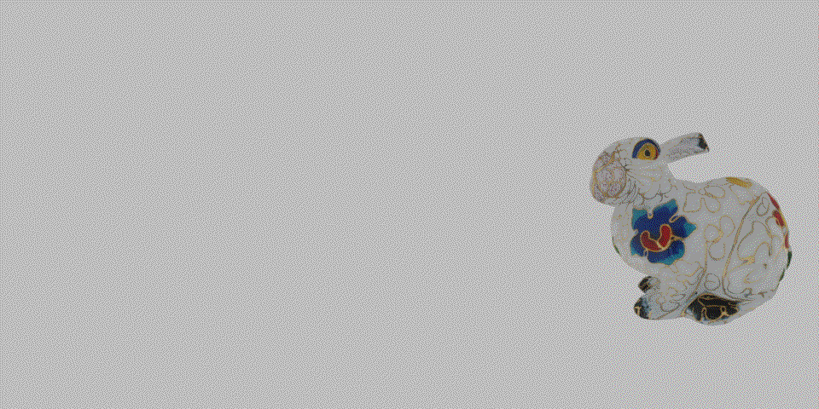
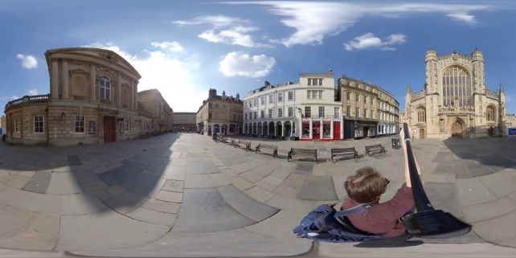
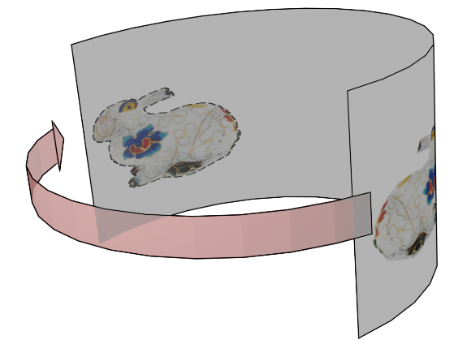
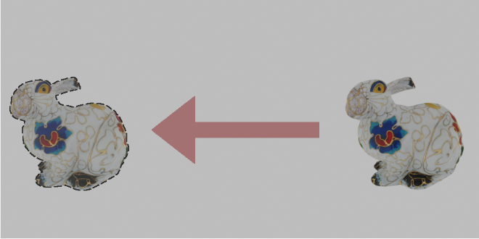
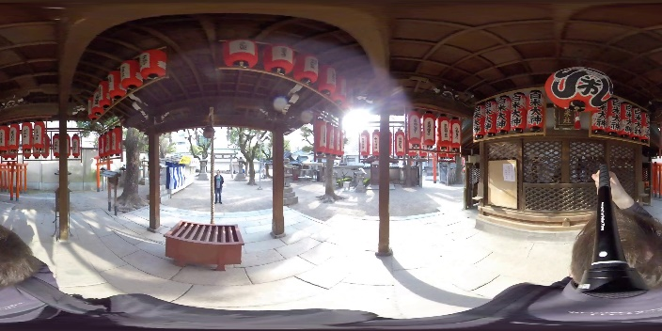
Problems – 360 optical flow definition
Motion
Perspective Image Optical Flow
360 Image Optical Flow
Problem 1: Large Distortion
Problem 2: Wrap-around
360 Optical Flow using Tangent Images, MZ Yuan and C Richardt
BMVC 2021
Page 3
Notes:
Comparing to the perspective image, the 360 images introduce two more problems.
First, large distortions.
Second, the motion's wrap-around.
To solve the wrap-around problem, we define the 360 optical flow is less than half image width.

Slide 4
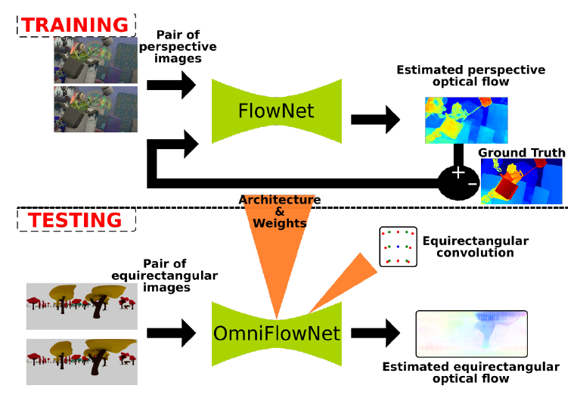
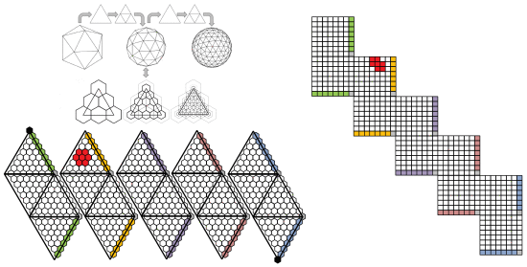
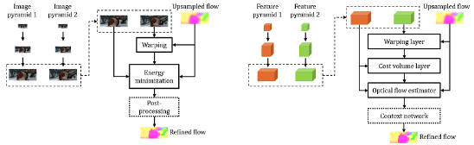
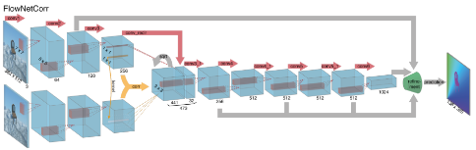
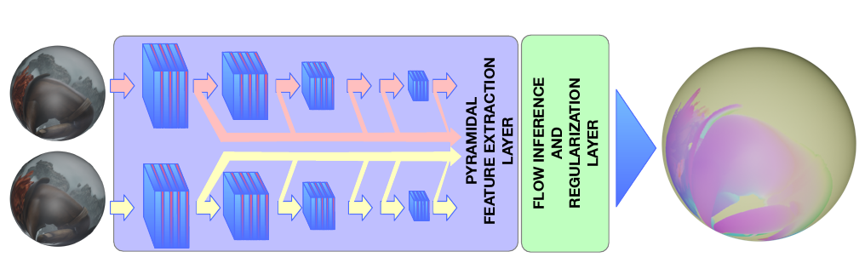
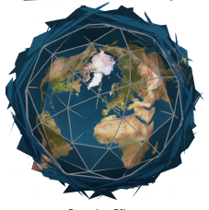
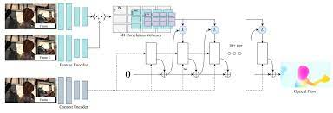
Related Work
PWC-Net
OmniFlownet
(Artizzu et al. ICPR 2021)
Luo et al. 2019
Flownet
360OpticalFlow
(Bhandari et al. ICPR 2021)
RAFT
Eder CVPR 2020
360 Optical Flow
Perspective Image Optical Flow
Tangent Image
360 Optical Flow using Tangent Images, MZ Yuan and C Richardt
BMVC 2021
Page 4
Notes:
The CNN based 360 optical flow is limited by the GPU memory size, it can not process high-resolution images.
And the perspective optical flow method can not be aware of the image distortion.
Inspired by the tangent image based method, we propose the range image base 360 optical flow method.

Slide 5
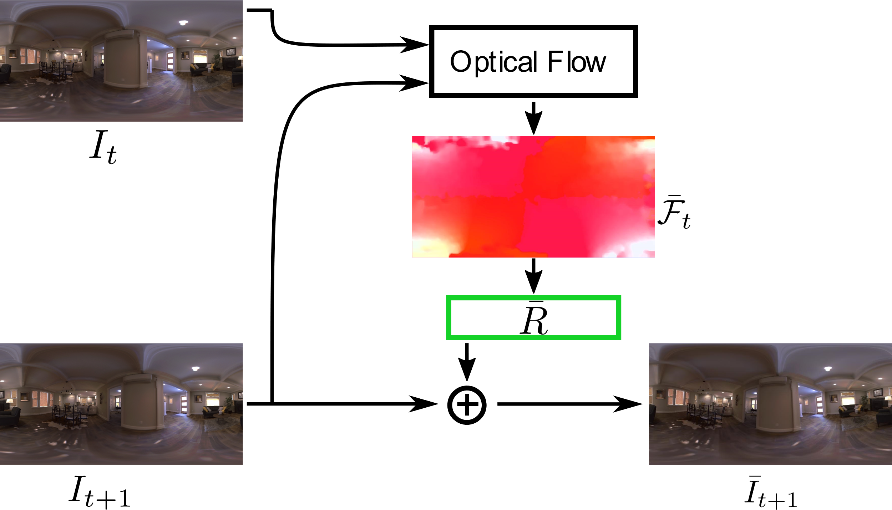
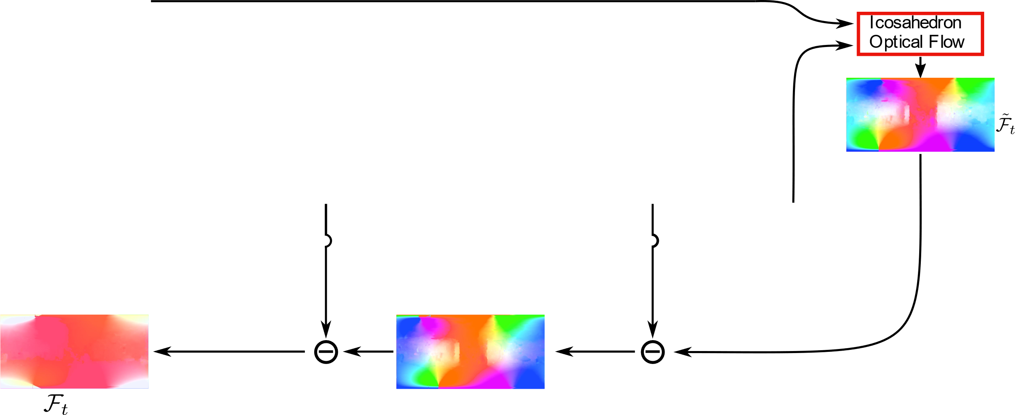
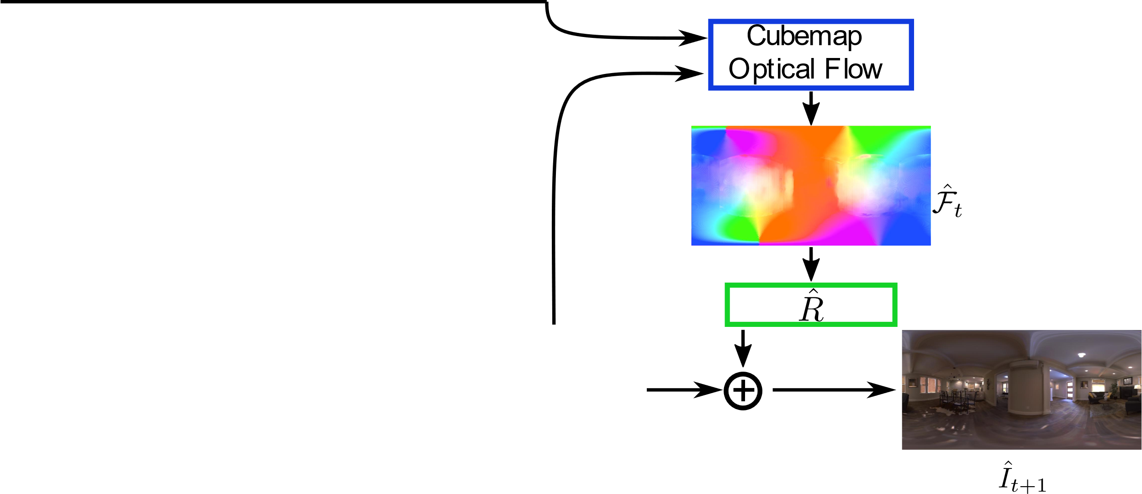
Method – pipeline
360 Optical Flow using Tangent Images, MZ Yuan and C Richardt
BMVC 2021
Page 5
Notes:
The key idea is to use the gnomonic projection extracting perspective image from 360 images,
and hire the global rotation warping to mitigate the two images relative motion.
The Method composes of 3 steps.
The first step is using the ERP optical flow to align the target image to the source image.
The second step is to use the cubemap optical flow to get rid of 360 distortions.
The third step is to use the icosahedron optical flow to refine the optical flow local detail, obtain the final 360 optical flow with the global rotation warping.

Slide 6
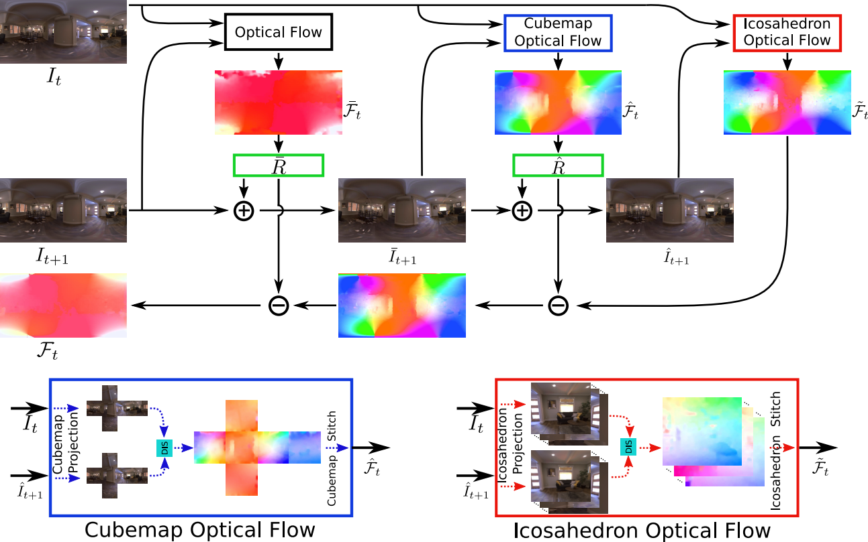
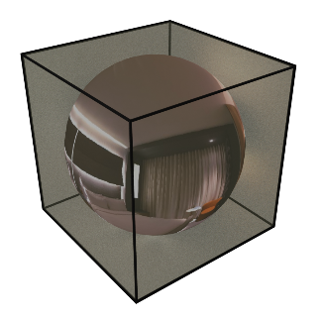
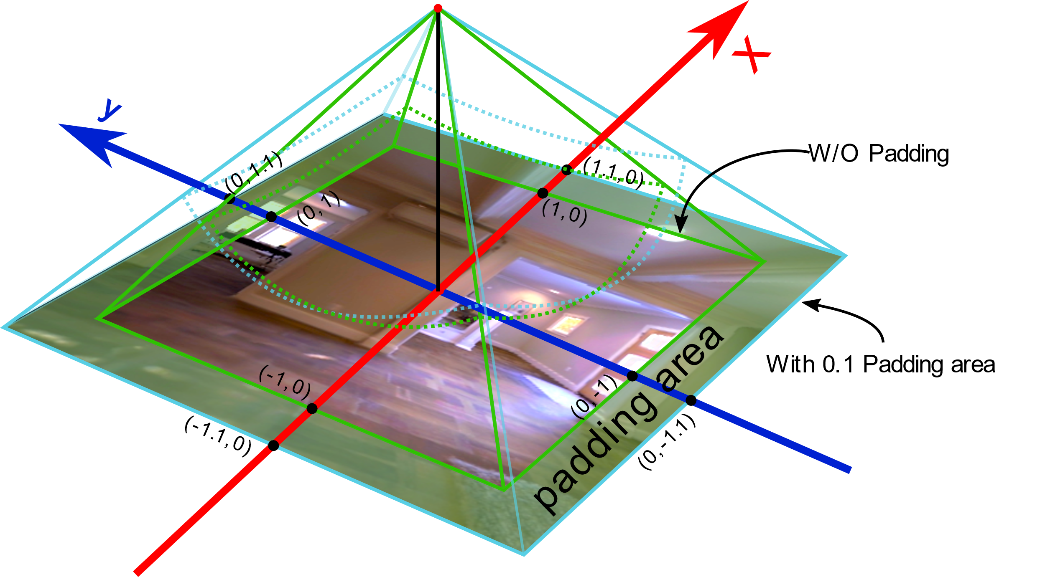
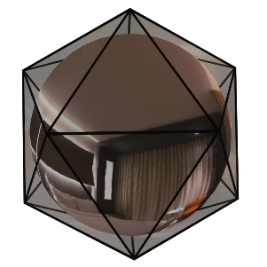
Method – Generate perspective images
360 Optical Flow using Tangent Images, MZ Yuan and C Richardt
BMVC 2021
Page 6
Notes:
To uniformly sample the 360 image pixels, the perspective images tangent point is the centre of the cubemap and icosahedron's surface.
And use the gnomonic projection to project the pixel from sphere surface to tangent images.
To keep the tangent images connection area's optical flow's consistency, we padded the tangent images and use the colour difference to blend the padded area's optical flow.

Slide 7
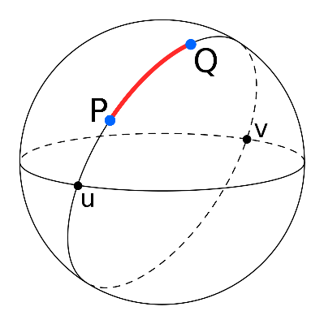


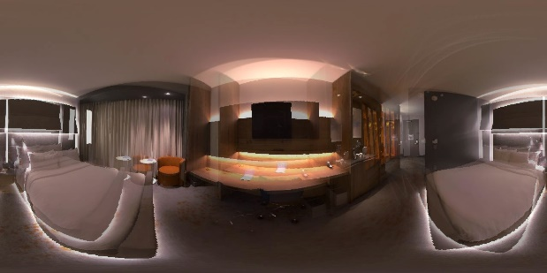
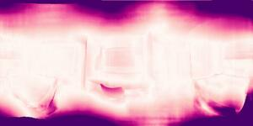

Result
Geodesic distance-based Error Metric:
SEPE, SAAE, SRME
Ours
OmniFlownet
RGB Images
PWCNet
RAFT
SEPE heatmap
360 Optical Flow using Tangent Images, MZ Yuan and C Richardt
BMVC 2021
Page 7
Notes:
To metric 360 optical flow error and get the ride of the distortion and wrap-around, we use the geodesic distance to replace the image pixels Euclidean distance. Propose SEPE, SAAE and SRME.
The experiment result shows that our method can dramatically improve the optical flow, especially at the top and bottom of 360 image.

